Slide 1
Coursera Capstone Project : Applied Data Science
Minh Dao
University of People
michaeldao91@gmail.com

Slide 2
Overview
Introduction
Business Problem
Data
District
Geocoding
Venue Data
Methodology
Accuracy of the Geocoding API
Folium
One hot encoding
Top 10 most common venues
Results Discussion
Conclusion

Slide 3
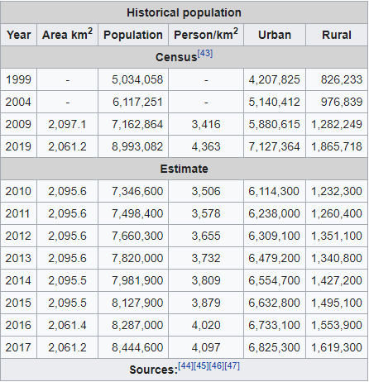
Introduction
2,061.2 km² with the population is over 10mil people
5 rural districts and 16 urban districts

Slide 4

Introduction
Leading economic engine with crowded population => fertile soil for any business Hence, in this particular report, I want to challenge myself to investigate what model could I follow in term of a new business.
Investigate what model could I follow in term of a new business.

Slide 5

Business Problem
Furthermore, Ho Chi Minh city has developed for not a long time; its business on the large scale seems to focus into personnel store in stead of large business with multifactor combination.
This is the case when I have noticed that the operational range of each business would be small into the residential area, hardly expanding to the whole city.

Slide 6
Data
Districts
Web scraping with the BeautifulSoup library for Python can be used to retrieve data from Ho Chi Minh City's neighborhoods. The information about the neighborhood was taken from a Wikipedia article. You could access to the wiki page in ('https://en.wikipedia.org/wiki/Category:Districts_of_Ho_Chi_Minh_City’).
Geocoding
The contents of the file hcmcity.csv are loaded into a Pandas Data Frame. The Google Maps Geocoding API is used to get the latitude and longitude of the Districts. The original dataframe is then modified with the geometric position values

Slide 7
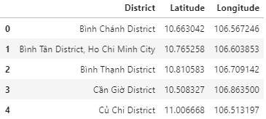
Data
Venue Data
The venue data is derived from the location data obtained after Web Scraping and Geocoding by transferring the necessary parameters to the FourSquare API and generating a new DataFrame that contains all of the venue information as well as the respective Districts.

Slide 8
Methodology
Accuracy of the Geocoding API
The number of incorrect results produced by the OpenCage Geocoder API was significant during the initial development process, prompting the creation of an algorithm to assess the accuracy of the Geocoding API in use. Geocoding APIs from different providers were checked as part of the algorithm, and Google Maps Geocoder API turned out to have the fewest collisions (errors) in our study.
Folium
Folium is based on the Python ecosystem's data wrangling capabilities and the leaflet.js library's mapping capabilities. Folium is used to visualize all clusters, and then produces a Leaflet map based on OpenStreetMap technology.

Slide 9
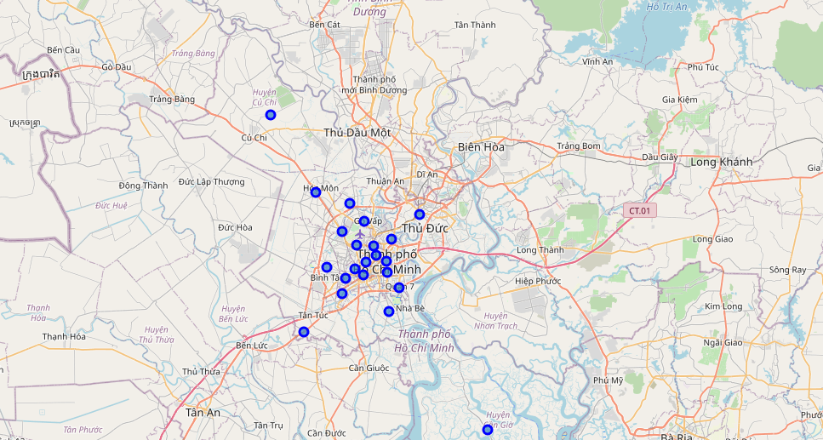
Methodology
Figure: Districts of HCM City.

Slide 10
Methodology
One hot encoding
One type of hot encoding is the conversion of categorical variables into a format that can be fed into machine learning algorithms to improve prediction accuracy. All specific things in the Venue Category are one-hot encoded for the K-means Clustering Algorithm
Top 10 most common venues
Because of the wide range of venues, only the top 10 are chosen, and a new DataFrame is created to train the K-means Clustering Algorithm.

Slide 11
Methodology
Optimal number of clusters
As compared to other clusters, the Silhouette Score is a measure of how close an object is to its own cluster (cohesion) (separation). The silhouette has a number of values ranging from -1 to +1, with a high value indicating that the object is well matched to its own cluster but poorly matched to neighboring clusters. The optimum cluster size is calculated based on the Silhouette Score of various clusters below 20.

Slide 12
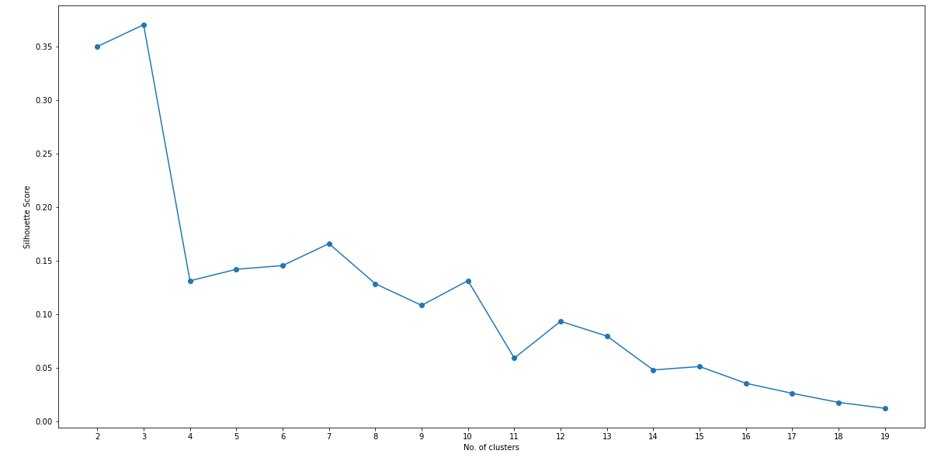
Methodology
Figure:Silhouette score vs No.of clusters.

Slide 13
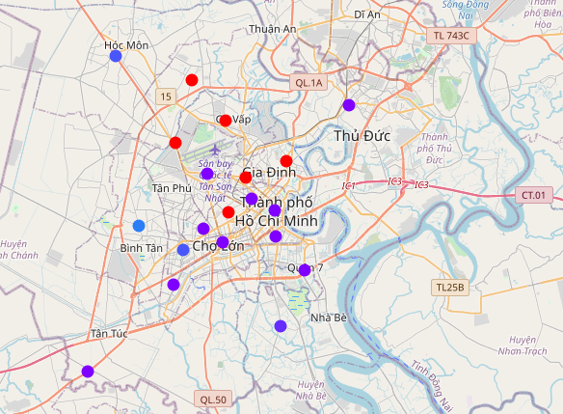
Results
The districts are divided into n clusters, with n denoting the number of clusters discovered using the best method. Different colors are used to visualize the clustered districts so that they can be distinguished.
Figure: Districts of HCM City (Clustered).

Slide 14
Discussion
After analyzing the various clusters produced by the Machine learning algorithm, I feel that almost any district is sticked to the food and beverage industry. Hence, it would be extreme in case of any intention to step into this field. There are still chances for fitness service in large scale business with modern devices. As I investigate the whole sectors, they are almost focused in social services rather than personal service.

Slide 15
Discussion
In circumstances of the hottest segments – food and beverage, I see the lack of variety in all clusters.
As well as for the clothing stores, I notice that the density is high in the center districts, which means that many clothing stores are located here.
Moreover, there is shortage of complex area and the store for toys as well as gifts. This could be worth-investing sectors in term of acknowledging what could satisfy customer needs. The average income of this city is not so high, so they would be a little picky and confused when deciding to buy those things
It would be a little strange when the electronics stores are not common. Maybe there is transition in buying habit from stores to online stores.

Slide 16
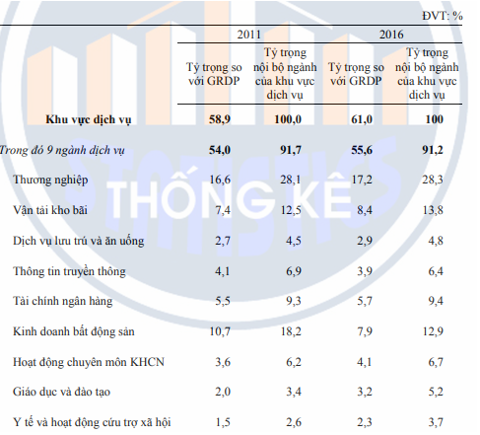
Discussion
Figure: Ratio of Industry Contribution

Slide 17
Conclusion
As the biggest city in Vietnam, Ho Chi Minh City has attracted many people to come and settle down here. This is not only opportunity to come up with better life, but a fierce competition in earning money for living.
More people, it means that more abilities that you could approach your potential customers. It is easy to see that almost the frequency in the data analysis turn to be food and beverage category. With the income in the middle level, people tend to focus most in the essentials for living, and eating come first in the list.
However, it could be a chance for you to expand in other categories, or in case that you could handle the issue of traffic jam and join the transportation industry.

